Slide 1
Chapter 3
Data Types in python

Slide 2
List of contents
Comments
Docstrings
How python sees variables
Data Types in python
Built-in types in python
bool Data Type
Sequences in python
Sets
Literals in python
Determining the Data types of a variable
What about characters
User defined data types
Constants in python
Identifiers and reserved words
Naming conventions in python

Slide 3
Comments
Single line comments
These comments starts with a hash symbol ( # )
Multi line comments
Triple double quotes or triple single quotes

Slide 4
Docstrings
In fact, Python supports only single line comments.
Multi line comments are treaded like regular strings with the exception that they can span multiple lines.
That means memory will be allocated to the strings internally
So it is not recommended to use multi line comments in python
API documentation file ( html file ) can be created by using python program
For this

Slide 5
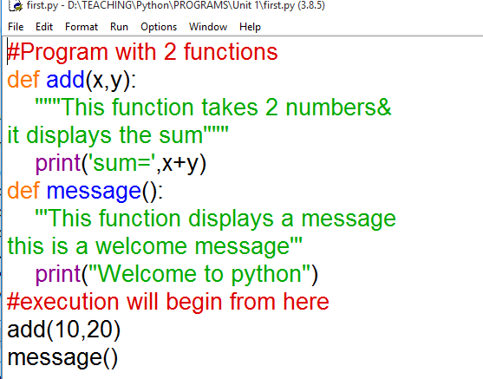
Execute this program in command prompt in order to create html file
>python -m pydoc -w first
sum= 30
Welcome to python
wrote first.html
Now open first.html file in any browser

Slide 6
How python sees variables
Suppose if we create variable a=2, python creates a memory for variable a
a
Then create a variable b=2 then this will happen in python
a
b
If we change the value of one of the variable then they will have different memory to each of the variables
2
2

Slide 7
Example
>>> a=2
>>> b=2
>>> id(a)
140732820100832
>>> id(b)
140732820100832
>>> b+=2
>>> id(b)
140732820100896
>>> id(a)
140732820100832

Slide 8
Data Types in python
A data type represents the type of data stored into a variable or memory
Data types which are already available in python language are called built-in data types
Data types which can be created by the programmers ate called user-defined data types

Slide 9
Built-in types in python
The None type
Numeric types
Representing Binary, Octal and Hexadecimal numbers
Converting the data types explicitly

Slide 10
None data type represents to an object that does not conation any value.
Numeric data types
int There is no limit for int datatype in python
float it can also be written in scientific notation where we use ‘e’ or ‘E’ to represent the power of 10.
Example x=22.55e3 which is equal to 22.55 x 10³
complex it is a number written in the form of a+bj
Example
c1=2.5+2.5j
c2=3.0-0.5j
print(“sum=“,c1+c2)

Slide 11
Representing Binary, Octal and Hexadecimal numbers
Binary number should be written by prefixing 0b (zero and b) or 0B
For example 0b110110
Hexadecimal numbers are written by prefixing 0x or 0X
For example 0x11fb91
Octal numbers are written by prefixing 0o of 0O
For example 0o145
Go to Jupyter notebook for examples
Converting the data types explicitly
int(x) is used to convert the number x into int data type
For example x=15.56
int(x) # will display 15
float(x) is used to convert x into float data type
For example x=15
float(x) # will display 15.0

Slide 12
complex(x) is used to convert x into a complex number
x=10
complex(x) # will display (10+0j)
complex(x,y)
x=10
y=-5
complex(x,y) # will display (10-5j)

Slide 13
bool Data Type
In python bool data type is represented by ‘True’ and ‘False’ Boolean values
python internally treats True as 1 and False as 0
Example :
a=10>5
print(a) # displays True
b=5>10
print(b) #displays False
Go to Jupyter notebook for examples

Slide 14
Sequences in python
A Sequence represents a group of elements or items
There are 6 types of sequences in python
str
bytes
bytearray
list
tuple
range

Slide 15
str datatype
It represents string data type
String is a group of characters
String are enclosed in single or double quotes
Example: str1=‘This is a string”
We can also write strings in triple single or triple double quotes
Example: str2=“””This is ‘core python’ book”””
The repetition operator is defined by ‘*’ symbol and useful to repeat the string for several times
Exmaple
s=‘Welcome to core python’
print(s*2)
o/p: Welcome to core pythonWelcome to core python
Slice operator represents square brackets [ and ] to retrieve pieces of a string
Go to Jupyter notebook for examples

Slide 16
bytes datatype
This is a datatype represents a group of byte numbers just like an array does
A byte number is any +ve integer form 0 to 255
Example:
Ele=[10,20,0,40,15]
X=bytes(Ele)
print(X[0]) # display 0th element, ie 10
We cannot modify or edit any element in the bytes array
Example:
Ele[2]=30 # display error
Go to Jupyter notebook for examples

Slide 17
bytearray datatype
bytes type is not modified but the bytearray datatype can be modified
Example
elements=[10,20,0,40,15]
x=bytearray(elements)
print("first element is ",x[0])
x[2]=30 # This is accepted

Slide 18
list datatype
It can store different types of data
It can grow in size dynamically in memory
Its memory allocation is not in continues order
List are represented using square brackets [ ], and the elements are written in it are separated by commas
Example: l=[10,20,32.65,’hello’]
Go to Jupyter notebook for examples

Slide 19
tuple datatype
It is similar to a list, elements in list can be modified (immutable)
But elements in tuple are not possible to modify (mutable)
To represent tuple parentheses ( ) are used
Example:
tpl=(10,-20,15.5,’mary’)
tpl[0]=99 # displays error

Slide 20
range datatype
The range datatype represents a sequence of numbers
The numbers in the range are nor modifiable
Generally, range is used for repeating a for loop
Example:
r=range(10)
for i in r:
print(i)
Go to Jupyter notebook for examples

Slide 21
set datatype
The order of elements is not maintained in a set
It means the elements may not appear in the same order as they are entered into the set.
Set does not accept duplicate elements
curly braces or flower brackets { } are used to denote set
Example: s = {10, ‘a’, 4.6}
Subtype is frozenset datatype, elements cannot be modified
Go to Jupyter notebook for examples

Slide 22
Mapping datatype
A map represents a group of elements in the form of key value pairs
The dict datatype is an example for a map
Key and its value are separated by a colon
Every pair should be separated by comma
All elements should be inside curly brackets { }
Example: d={10:”mmvc”,5:256215,20:[1,2,3]}
A dictionary can be empty without any elements
Example: dic={}
Go to Jupyter notebook for examples

Slide 23
Literals in python
A literal is a constant value that is stored into a variable in a program
Example: a=15
Here ‘a’ is a variable which stores value 15. Hence the value 15 is called literal
Literals are 3 types
Numeric literals
Boolean literals
String literals

Slide 24
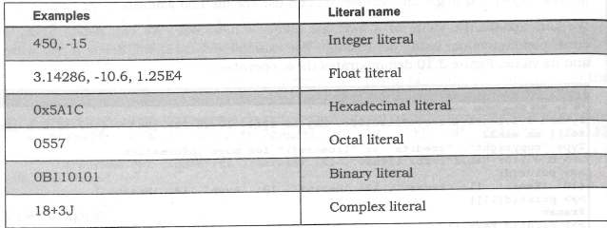
Numeric literals
Boolean literals:
True or False

Slide 25
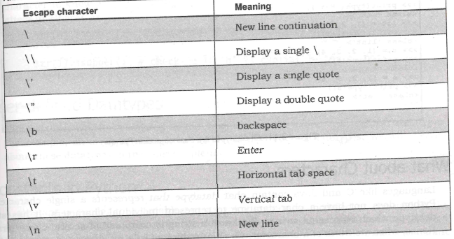
String literals
A group of characters is called string literal

Slide 26
Determining the Data types of a variable
By using built in type function we can find data type of a variable
Example:
A=15
print(type(A))
o/p: <class ‘int’>

Slide 27
What about characters?
Python does not have a char data type to represent individual character
It has str data type to handle character and string
Example:
ch=‘a’
print(type(a))
o/p: <class ‘str’>

Slide 28
User defined data types
The data types which created by the programmer are called ‘user-defined data types’
For example, an array, a class, a module

Slide 29
Constants in python
Constant is similar to a variable but its value cannot be modified or changed
C, java supports constants
But in python, it is not possible to create constant
A programmer can define constant by writing its name in all capital letters

Slide 30
Identifiers and reserved words
An identifier is a name that is given to a variable or function or class etc.
Identifier can include letters, numbers, and the underscore character
They should always start with non numeric character
Special symbols such as ?,@,$,!, etc are not allowed
Case sensitive

Slide 31
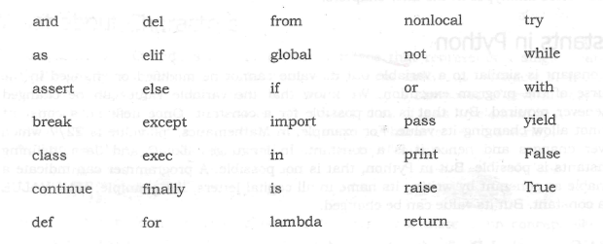
Reserved words

Slide 32
Naming conventions in python
Packages: package name should be written all lower case letters. When multiple words are used for a name, we should separate them using underscore( _ )
Modules:
all lower case
Separated with underscore
Classes:
Programmer class should Star with capital letter
Built in class will be with lowercase, Except exceptions
Global variables or module-level variables
all lower case
Separated with underscore

Slide 33
Instance variables:
all lower case
Separated with underscore
Non public instance variables should begin with underscore
Functions or methods:
all lower case
Separated with underscore
Method arguments:
In case of instance method, first argument should be ‘self’
In case of class method, first argument name should be ‘cls’
Constants:
All capital letter
Separated with underscore

Slide 34
Non accessible entities:
Some variables, functions, and methods are not accessible

